Slide 1

OCI Web Application Firewall
Balasubramannyam Sunil
Cloud Lift Services Implementation Specialist

Slide 2
Agenda
What is OCI WAF ?
Key Capabilities of OCI WAF
Demo

Slide 3
What is OCI WAF ?
Oracle WAF uses a multilayered approach to protect web applications from a host of cyber threats including malicious bots, application layer (L7) DDoS attacks, cross-site scripting, SQL injection, and vulnerabilities defined by the Open Web Application Security Project (OWASP)

Slide 4
What is OCI WAF ?
Protect applications from malicious and unwanted internet traffic with a cloud-based, PCI-compliant, global web application firewall service.
Integrated threat intelligence
Monitor and control access to web applications (geolocation data, whitelisted and blacklisted IP addresses, HTTP URL, and HTTP header.)
Active bot management (advanced set of verification methods, including JavaScript, CAPTCHA, device fingerprinting, and human interaction algorithms.)

Slide 5
Key Capabilities of OCI WAF
Protection Rules
Access Control
Threat Intelligence
Bot Management

Slide 6
Zenedge
The Oracle Cloud Infrastructure WAF is based on Oracle Zenedge.
Zenedge is a leading, global provider of cloud-based, artificial intelligence-driven cybersecurity solutions. Zenedge solutions are powered by proprietary artificial intelligence (AI) technology, inspecting web traffic in real-time, identifying threats and behavior anomalies and dynamically updating security postures accordingly. On February 15, 2018, Oracle announced that it signed an agreement to acquire Zenedge, adding leading cloud-based network and infrastructure security capabilities to protect enterprises from today's complex digital threats.

Slide 7
DEMO
Notes:
No Need for this

Slide 8
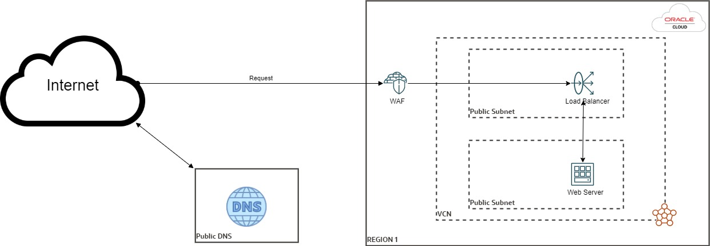
Arch

Slide 9
Q & A

Slide 10
Useful Links
https://www.oracle.com/in/a/ocom/docs/security/5-reasons-you-need-web-application-firewall.pdf
https://www.oracle.com/in/a/ocom/docs/security/oci-web-application-firewall.pdf
https://blogs.oracle.com/cloudsecurity/post/oracle-cloud-infrastructure-web-application-firewall-in-action
https://www.ateam-oracle.com/enhance-security-with-oracle-cloud-infrastructures-web-application-firewall

Slide 11
Thank You ☺
11
Copyright © 2020, Oracle and/or its affiliates | Confidential: Highly Restricted

